Slide 1
6 Tips to Protect Your Device from Hacking
By Kevin Wen
ID 18549

Slide 2

1.Keep your software up to date
Regularly update your operating system, applications, and antivirus software to patch security vulnerabilities and protect against the latest threats.

Slide 3
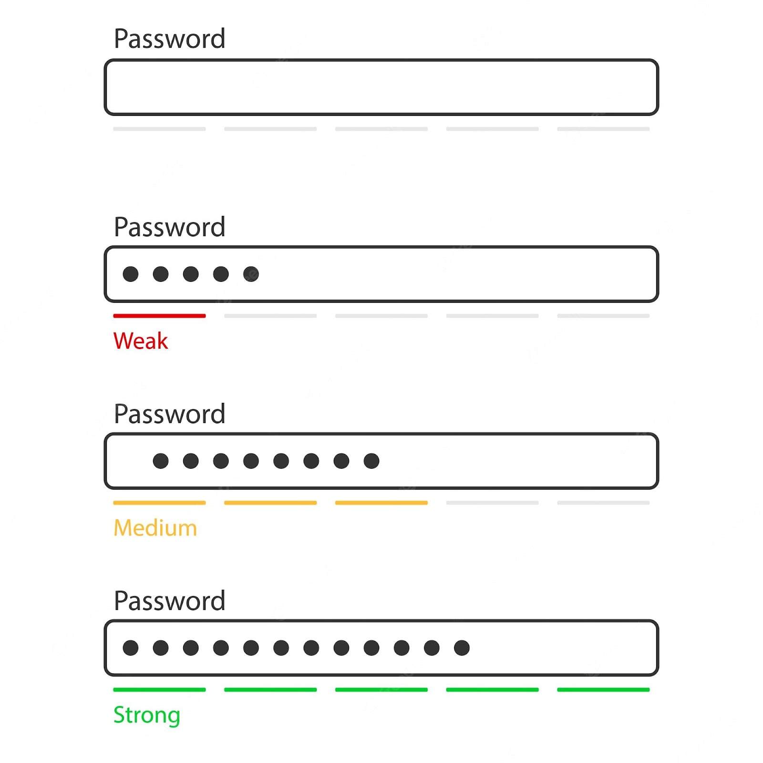
2.Use strong, unique passwords
Create strong, complex passwords for all your accounts and avoid using the same password across multiple platforms. Consider using a reputable password manager to securely store and manage your passwords.

Slide 4
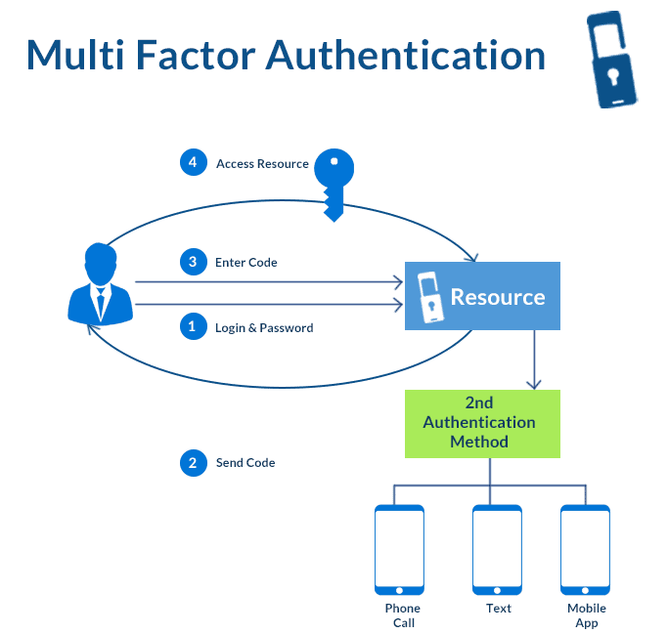
3.Enable multi-factor authentication (MFA)
Enable MFA whenever possible to add an extra layer of security to your accounts. MFA requires additional verification beyond just a password, such as a code sent to your phone or email, making it harder for hackers to gain unauthorized access.

Slide 5
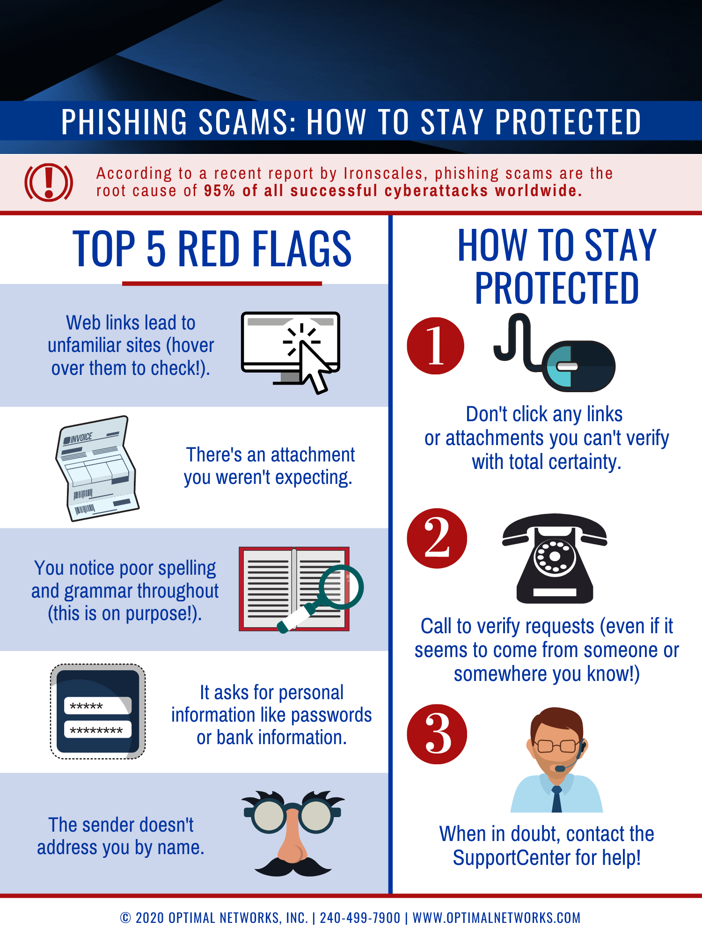
4.Be cautious of phishing attempts
Be vigilant against phishing emails, texts, or calls that attempt to trick you into revealing sensitive information or clicking on malicious links. Verify the sender's identity and avoid providing personal or financial information unless you're certain of the recipient's legitimacy.

Slide 6
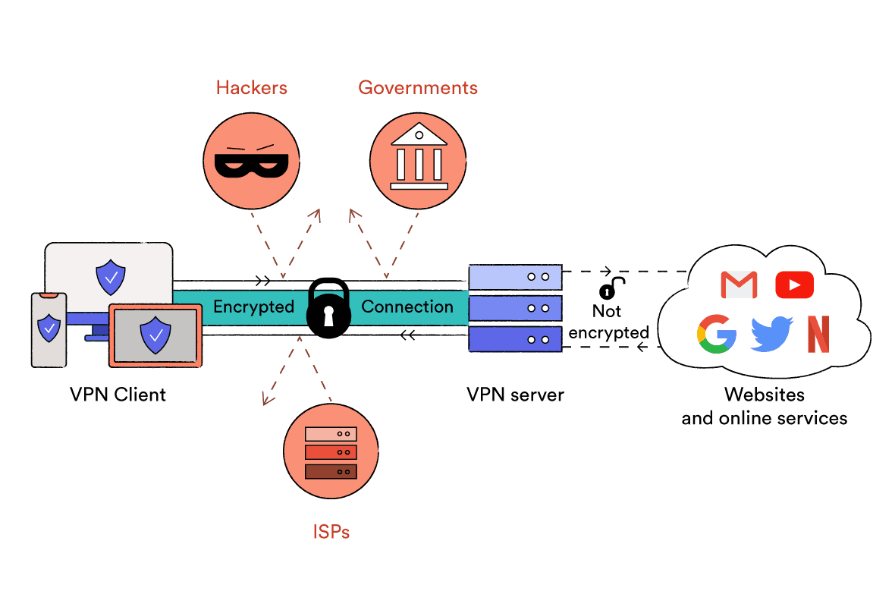
5.Use a virtual private network (VPN)
When accessing the internet, especially on public Wi-Fi networks, use a VPN to encrypt your internet connection and protect your data from potential hackers or eavesdroppers. A VPN creates a secure tunnel between your device and the internet, keeping your online activities private and secure."

Slide 7
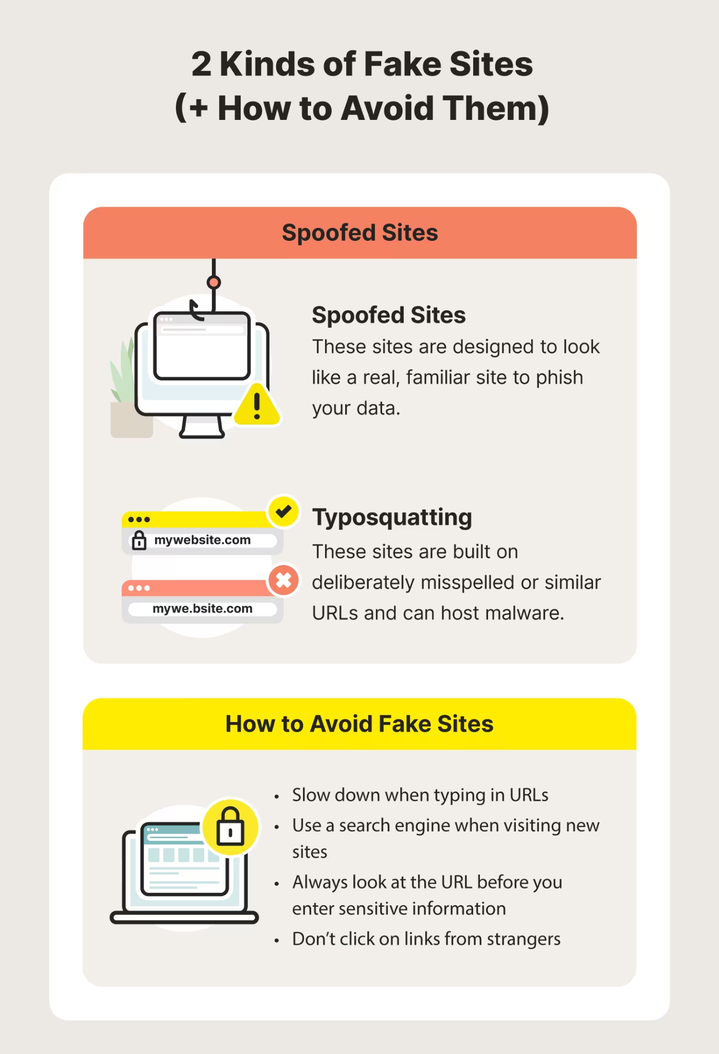
6.Practice safe browsing habits
Avoid visiting suspicious websites or clicking on untrusted links, as they may contain malware or phishing attempts. Be cautious when downloading files or software from the internet and only download from reputable sources

Slide 8
Conclusion
You can significantly reduce the risk of your device being hacked and encouragement to implement the tips discussed to protect against hacking and safeguard personal information.

Slide 9


